Slide 1
Imputation for Provisional COVID-19 Deaths in 2020

Slide 2
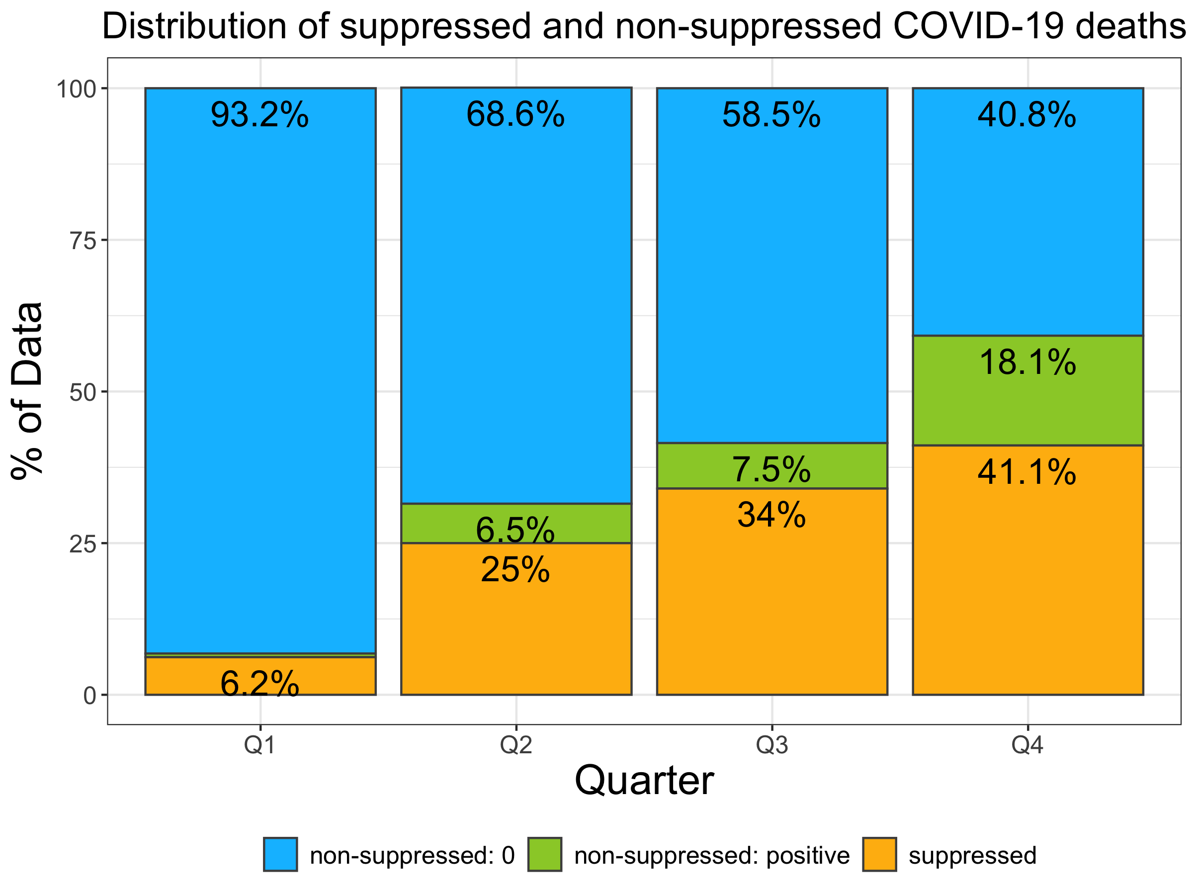
Why imputation?
County-level COVID-19 death counts from 1 to 9 were suppressed
The percent of data with suppressed COVID-19 death counts increased from Q1 to Q4
Could bias the estimates of the years of potential life loss (YPLL) due to COVID-19
Non-suppressed data: 0 COVID-19 death reported
Non-suppressed data: ≥10 COVID-19 deaths reported
Suppressed data: 1-9 COVID-19 deaths reported
Notes:
The dataset that we received was quarterly COVID-19 death count by 7 age group in each county in the US.
The reason why we explored imputation method for this study is because the county-level COVID-19 death data had data suppression for death counts between 1 and 9.
For example, if a county reported 7 COVID-19 death for age group 40-49 in quarter 4, the value was blank or suppressed in the dataset that we received.
Here is the distribution of suppressed and non-suppressed COVID-19 deaths in the dataset. Blue represents the % of data with ZERO COVID-19 deaths. There is no suppression for 0 deaths. Green represents the % of 10 or more COVID-19 deaths, which are not suppressed. Orange represents the % of suppressed data, which were 1-9 COVID-19 deaths.

Slide 3
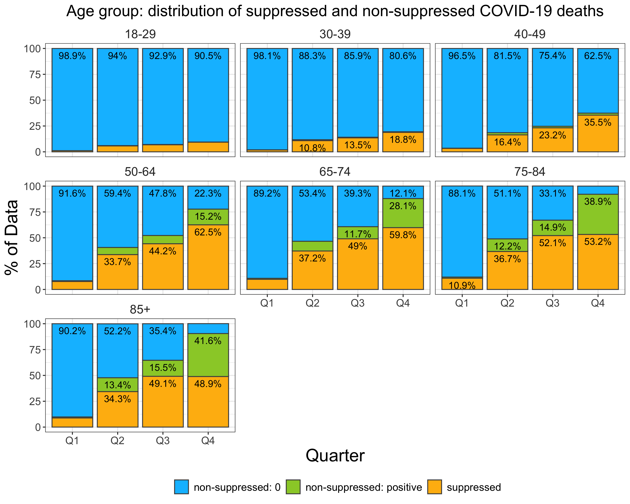
Data type by age group
More suppressed data among older age groups
More zeros among younger age groups (18-29, 30-39, 40-49)
Non-suppressed data: 0 COVID-19 death reported
Non-suppressed data: ≥10 COVID-19 deaths reported
Suppressed data: 1-9 COVID-19 deaths reported

Slide 4
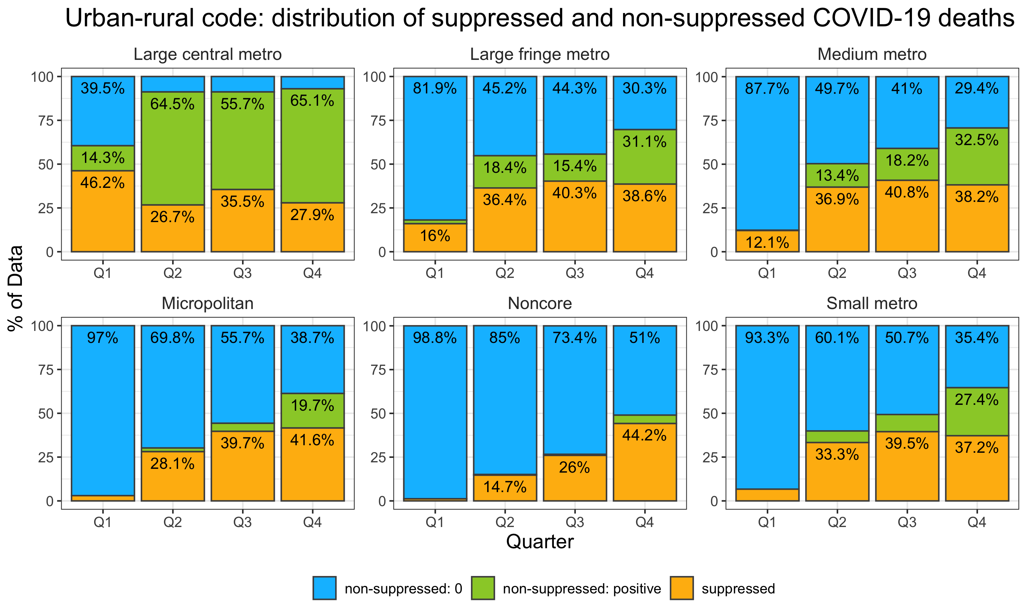
Data type by county type (urban/rural)
The pattern of counties with zeros and suppressed data varied with the types of counties
Large central metro had a very different pattern than the other types of counties
Large fringe, medium, and small metro had a similar pattern of zeros and suppressed data
Non-suppressed data: 0 COVID-19 death reported
Non-suppressed data: ≥10 COVID-19 deaths reported
Suppressed data: 1-9 COVID-19 deaths reported

Slide 5
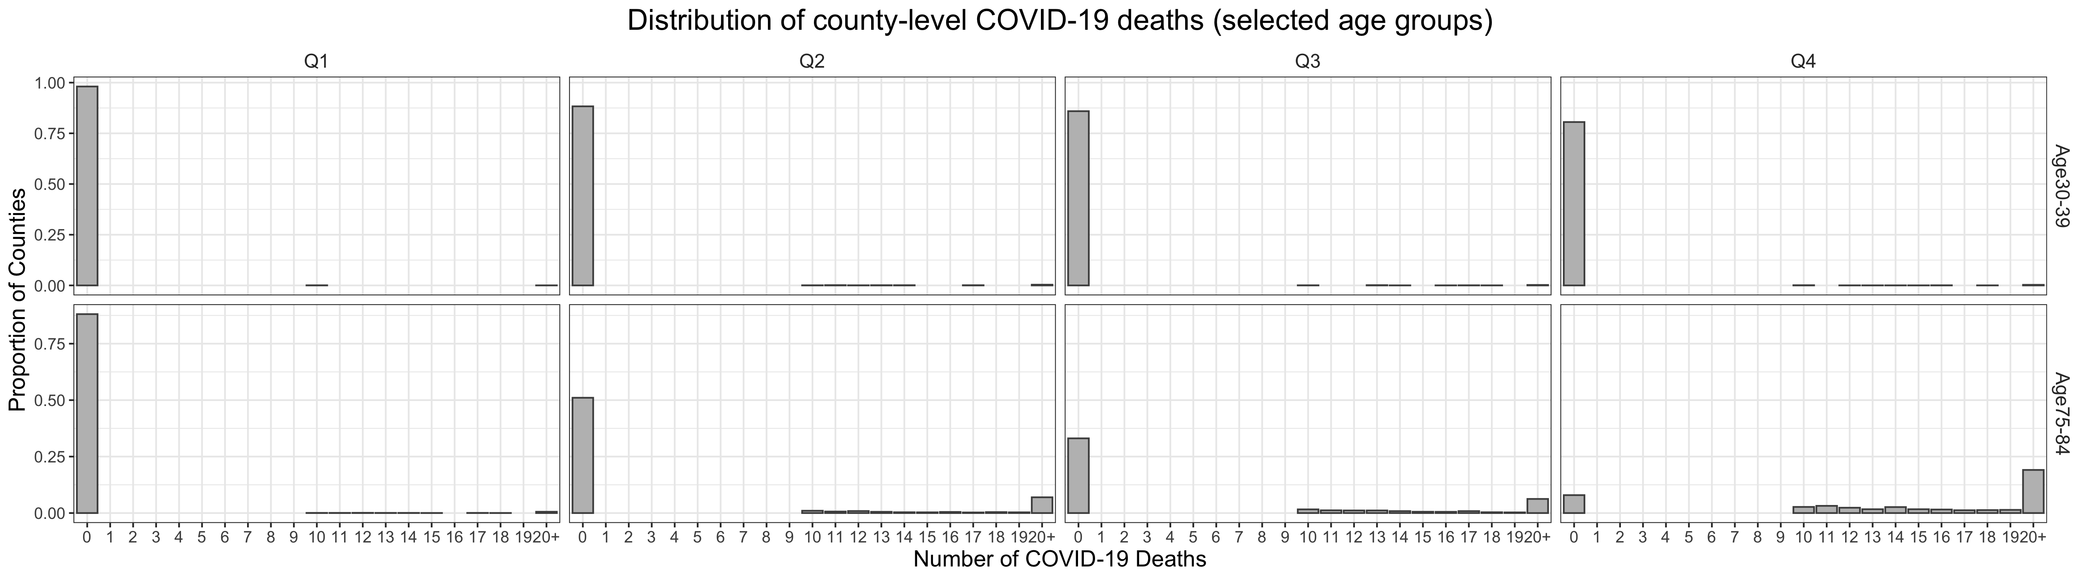
Distribution of COVID-19 deaths
Note: Number of COVID-19 deaths was top-coded at 20. All death counts ≥ 20 were collapsed into “20+”
A large mass of zero COVID-19 deaths
In early pandemic (e.g., Q1 and Q2)
Among younger age groups

Slide 6
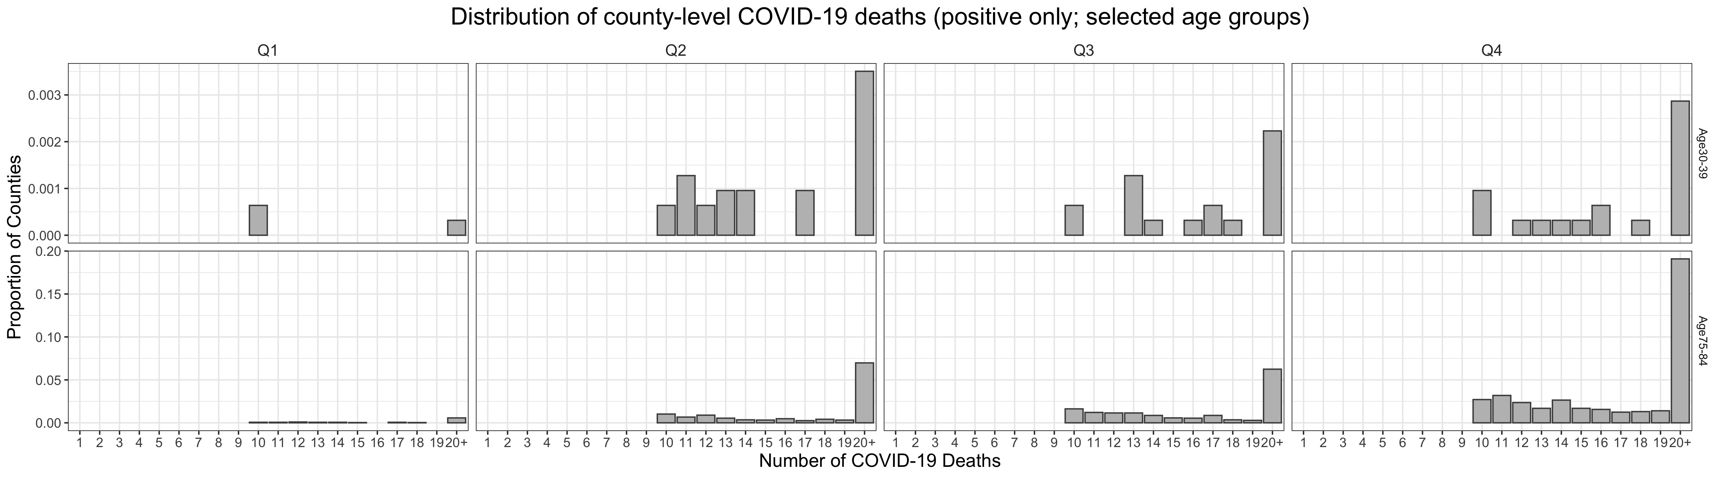
Distribution of COVID-19 deaths
Note: Number of COVID-19 deaths was top-coded at 20. All death counts ≥ 20 were collapsed into “20+”
A large mass of zero COVID-19 deaths among counties
Positive death counts follow a right-skewed distribution
The largest value is 1,505 COVID-19 deaths among the population aged 75-84 in Queens County, NY in quarter 2

Slide 7
Distribution of COVID-19 deaths
The suppressed COVID-19 death counts have to follow some hypothetical distribution
Have a large mass of zero
Right-skewed distribution
Other determinants
Temporal trend
Age group
Type of county (urban/rural)
Population size
State trend
Distribution of county-level COVID-19 deaths (positive only): Age 75-84; Quarter 4
3
?
Proportion of Counties
2
1
Number of COVID-19 Deaths
Note: Number of COVID-19 deaths was top-coded at 20. All death counts ≥ 20 were collapsed into “20+”

Slide 8
Methods
Population:
3,138 counties (removed 2 counties due to no population estimates)
Data:
COVID-19 Deaths: AH Provisional COVID-19 Deaths by Quarter, County and Age for 2020
Population estimates by age group: American Community Survey 5-Year Estimates
Methods: Bayesian multilevel gamma hurdle model
Estimate the probability of having 0 deaths and positive deaths
Estimate the positive deaths with a right-skewed distribution
3 levels: time trend, county level, and state level
Factors included: quarters, age groups, type of county, population size
Detailed model specification in the appendix

Slide 9




Why Bayesian method?
Prior
Algorithm:
MCMC,
Random field, etc
$$P(θ)$$
Posterior
Likelihood
$$P(θ|Y)$$
1
9
Posterior distribution
$$P(y_{i}|θ)$$
If we can reconstruct the posterior distribution, we can get the credible values for the suppressed data by sampling from the posterior distribution.

Slide 10
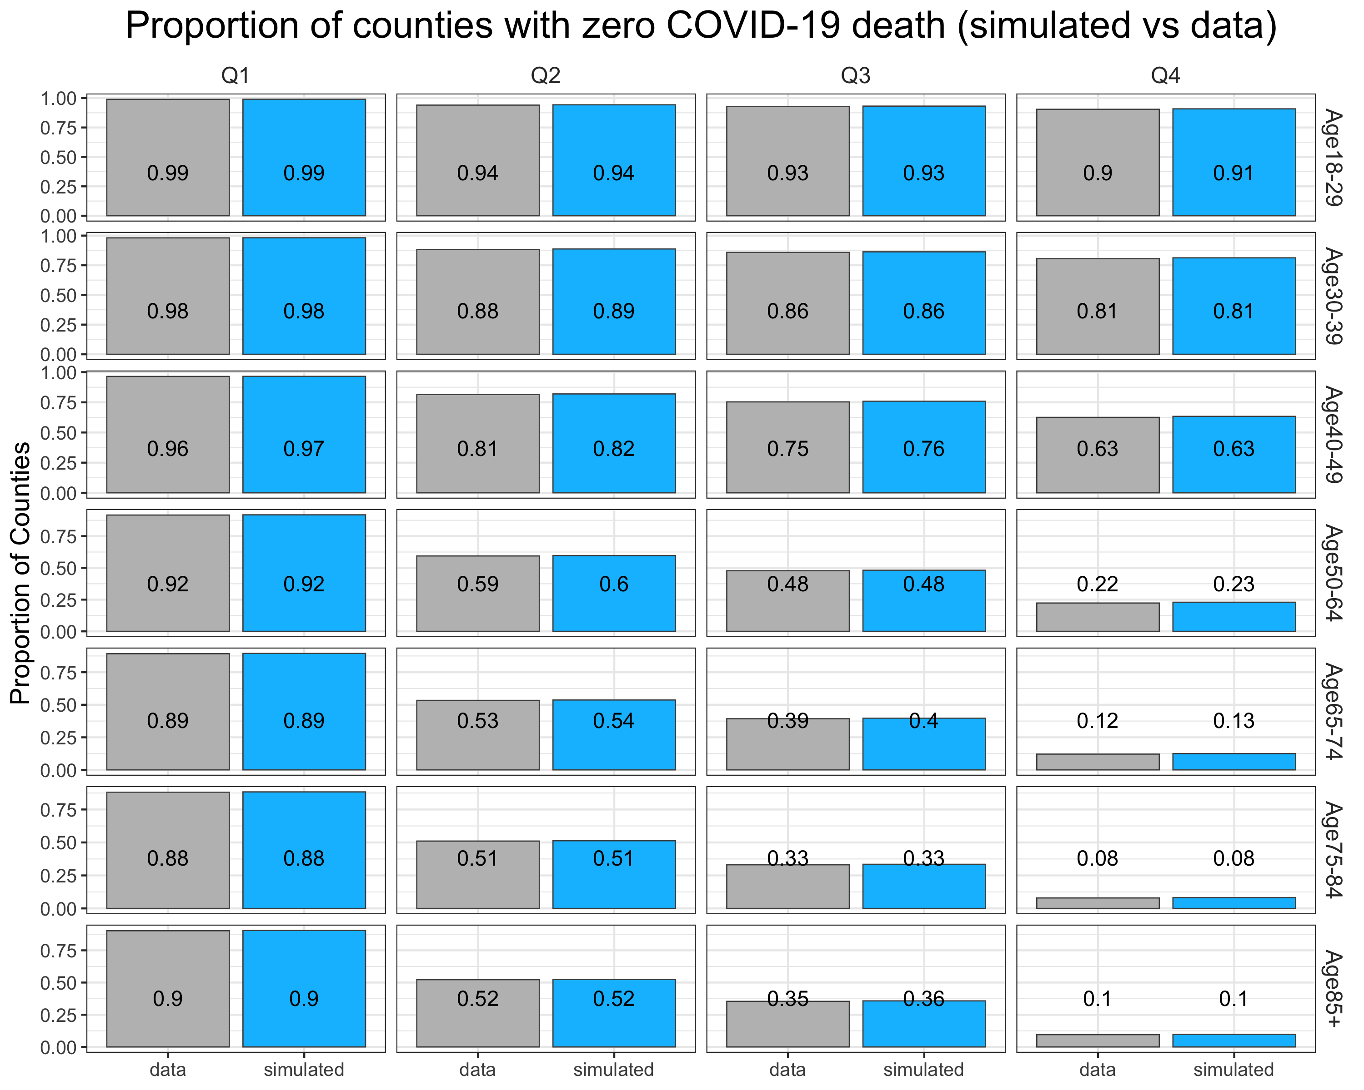
Simulated data vs non-suppressed data
This is to check whether the bayesian method created a plausible distribution
The proportions of counties with zero COVID-19 deaths are similar between the simulation from the posterior distribution and non-suppressed data

Slide 11
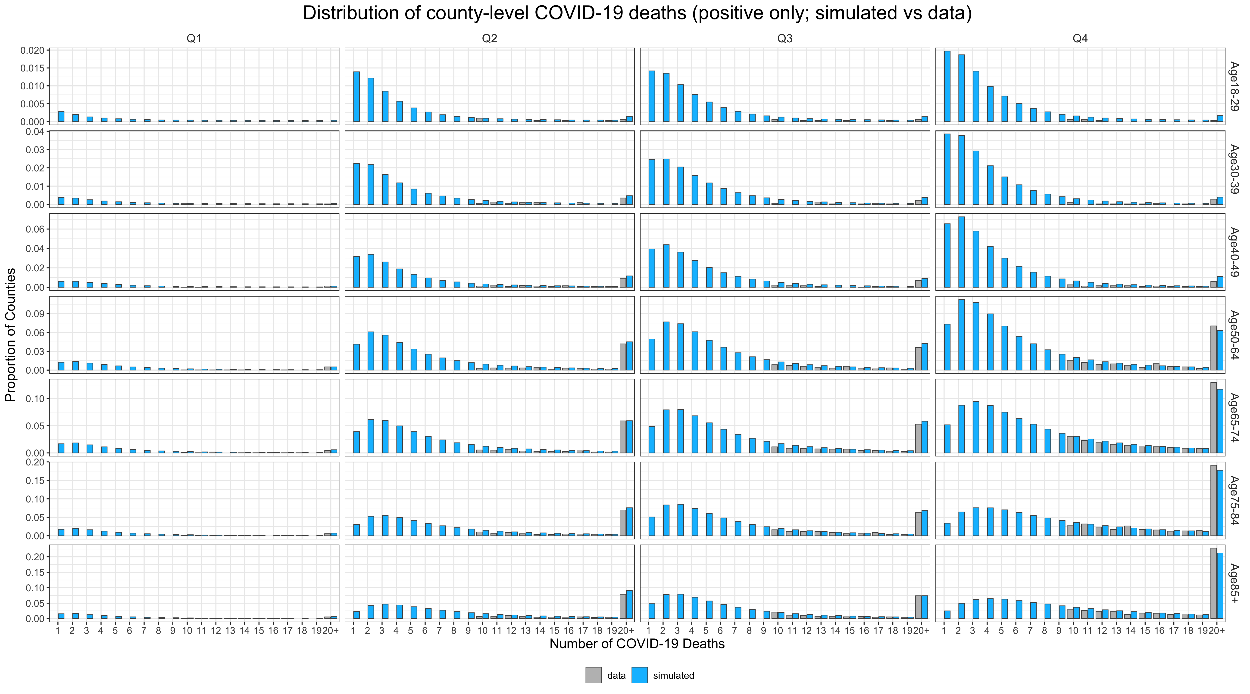
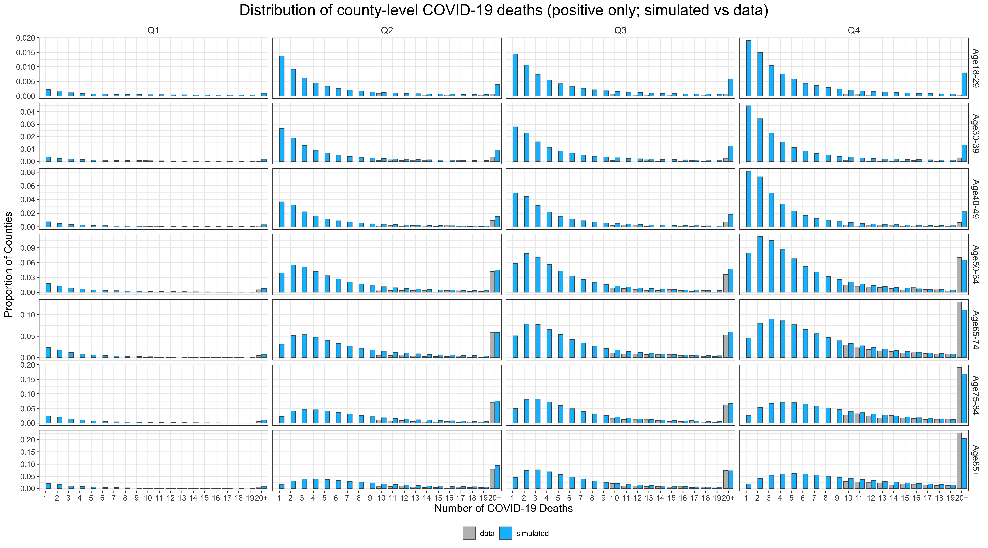
Simulated data vs observed data
Observed data
Simulated data

Slide 12
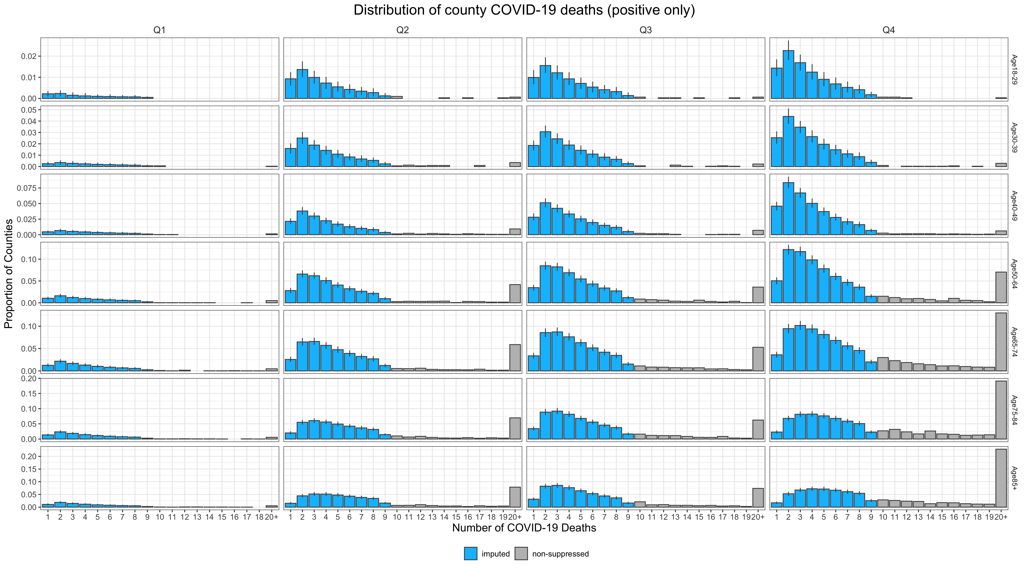
Combine imputed and observed data
Observed data
Imputed data

Slide 13
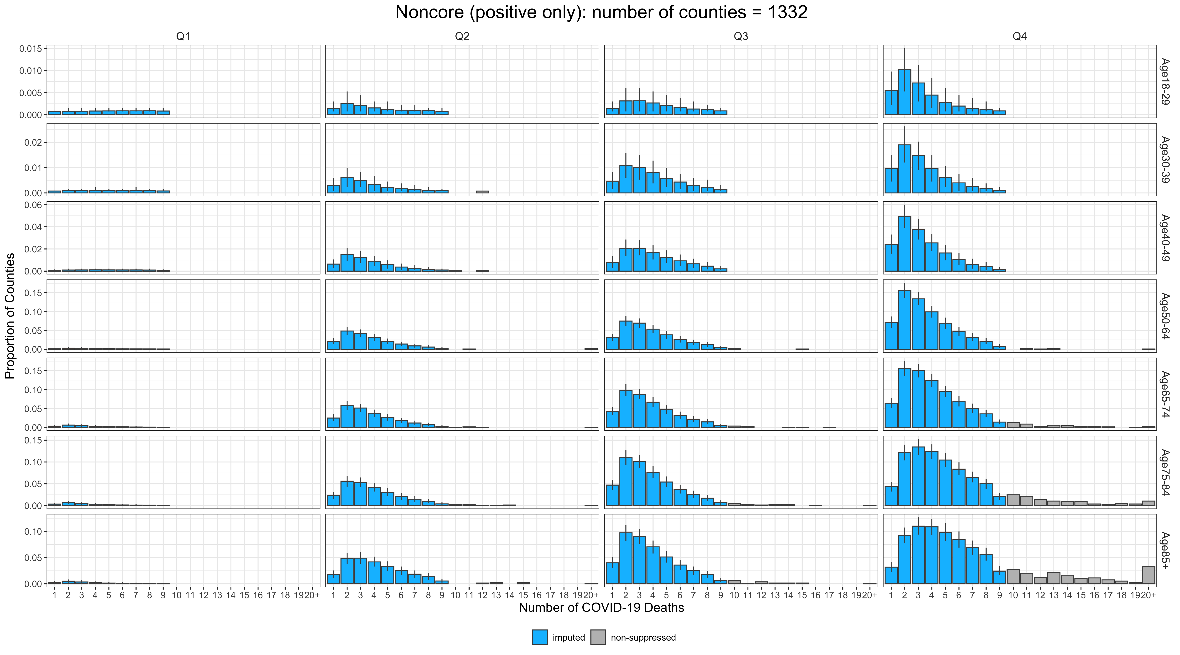
Imputation: Noncore counties
Observed data
Imputed data

Slide 14
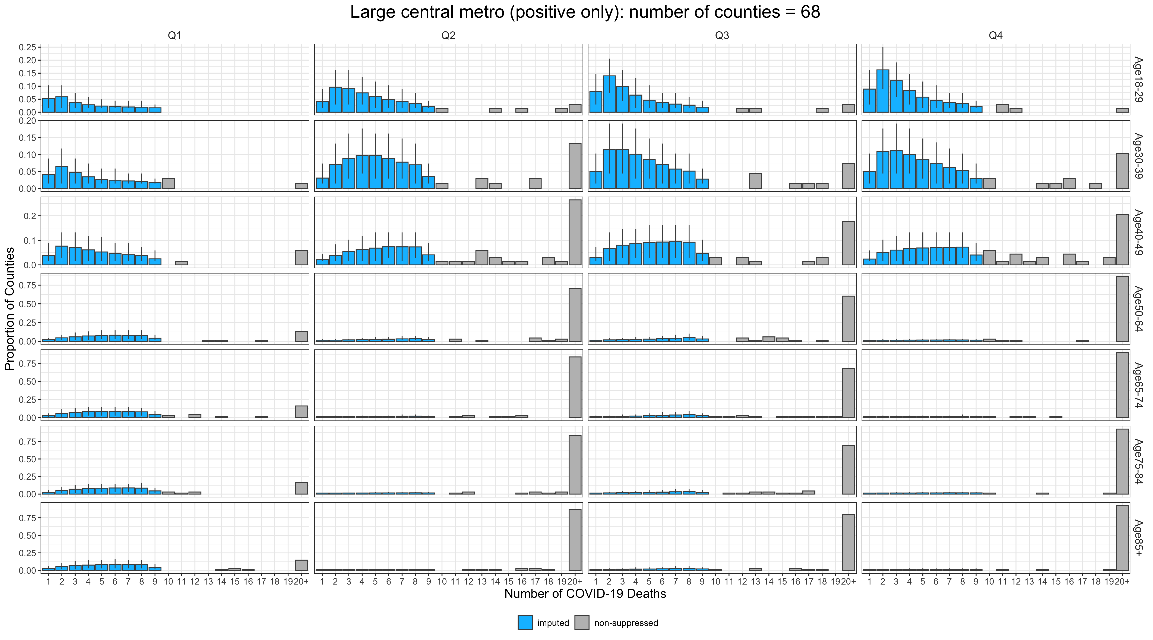
Imputation: Large central metro
Observed data
Imputed data

Slide 15
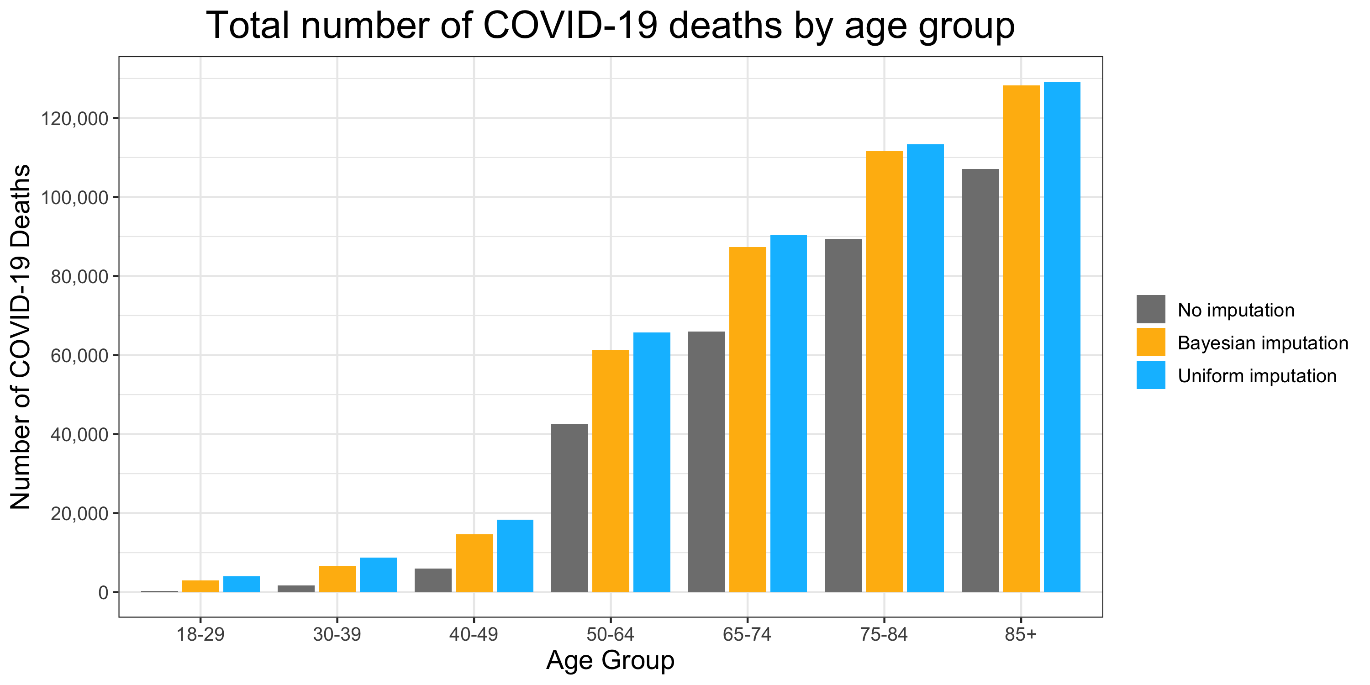
Estimated COVID-19 deaths in 2020
Uniform imputation is to random sample values between 1 and 9 from a uniform distribution
 | Estimated COVID-19 deaths in 2020
Age group | Provisional county-level data (no imputation) | Bayesian imputation (mean) | Uniform imputation (mean)
18-29 | 347 | 2,945 | 3,950
30-39 | 1,701 | 6,907 | 8,754
40-49 | 5,992 | 15,171 | 18,293
50-64 | 42,538 | 61,556 | 65,768
65-74 | 65,905 | 87,106 | 90,353
75-84 | 89,367 | 111,061 | 113,339
≥85 | 107,056 | 127,816 | 129,195

Slide 16
Comparison
Age group | No. of COVID-19 related death certificates | Provisional county-level data (no imputation) | % under-estimated | Bayesian imputation (mean) | % over-estimated
18-29 | 1,426 | 347 | 76% | 2,945 | 107%
30-39 | 4,161 | 1,701 | 59% | 6,907 | 66%
40-49 | 11,053 | 5,992 | 46% | 15,171 | 37%
50-64 | 55,719 | 42,538 | 24% | 61,556 | 10%
65-74 | 80,705 | 65,905 | 18% | 87,106 | 8%
75-84 | 104,294 | 89,367 | 14% | 111,061 | 6%
≥85 | 120,508 | 107,056 | 11% | 127,816 | 6%
Total | 377,866 | 312,906 | 17% | 412,563 | 9%

Slide 17
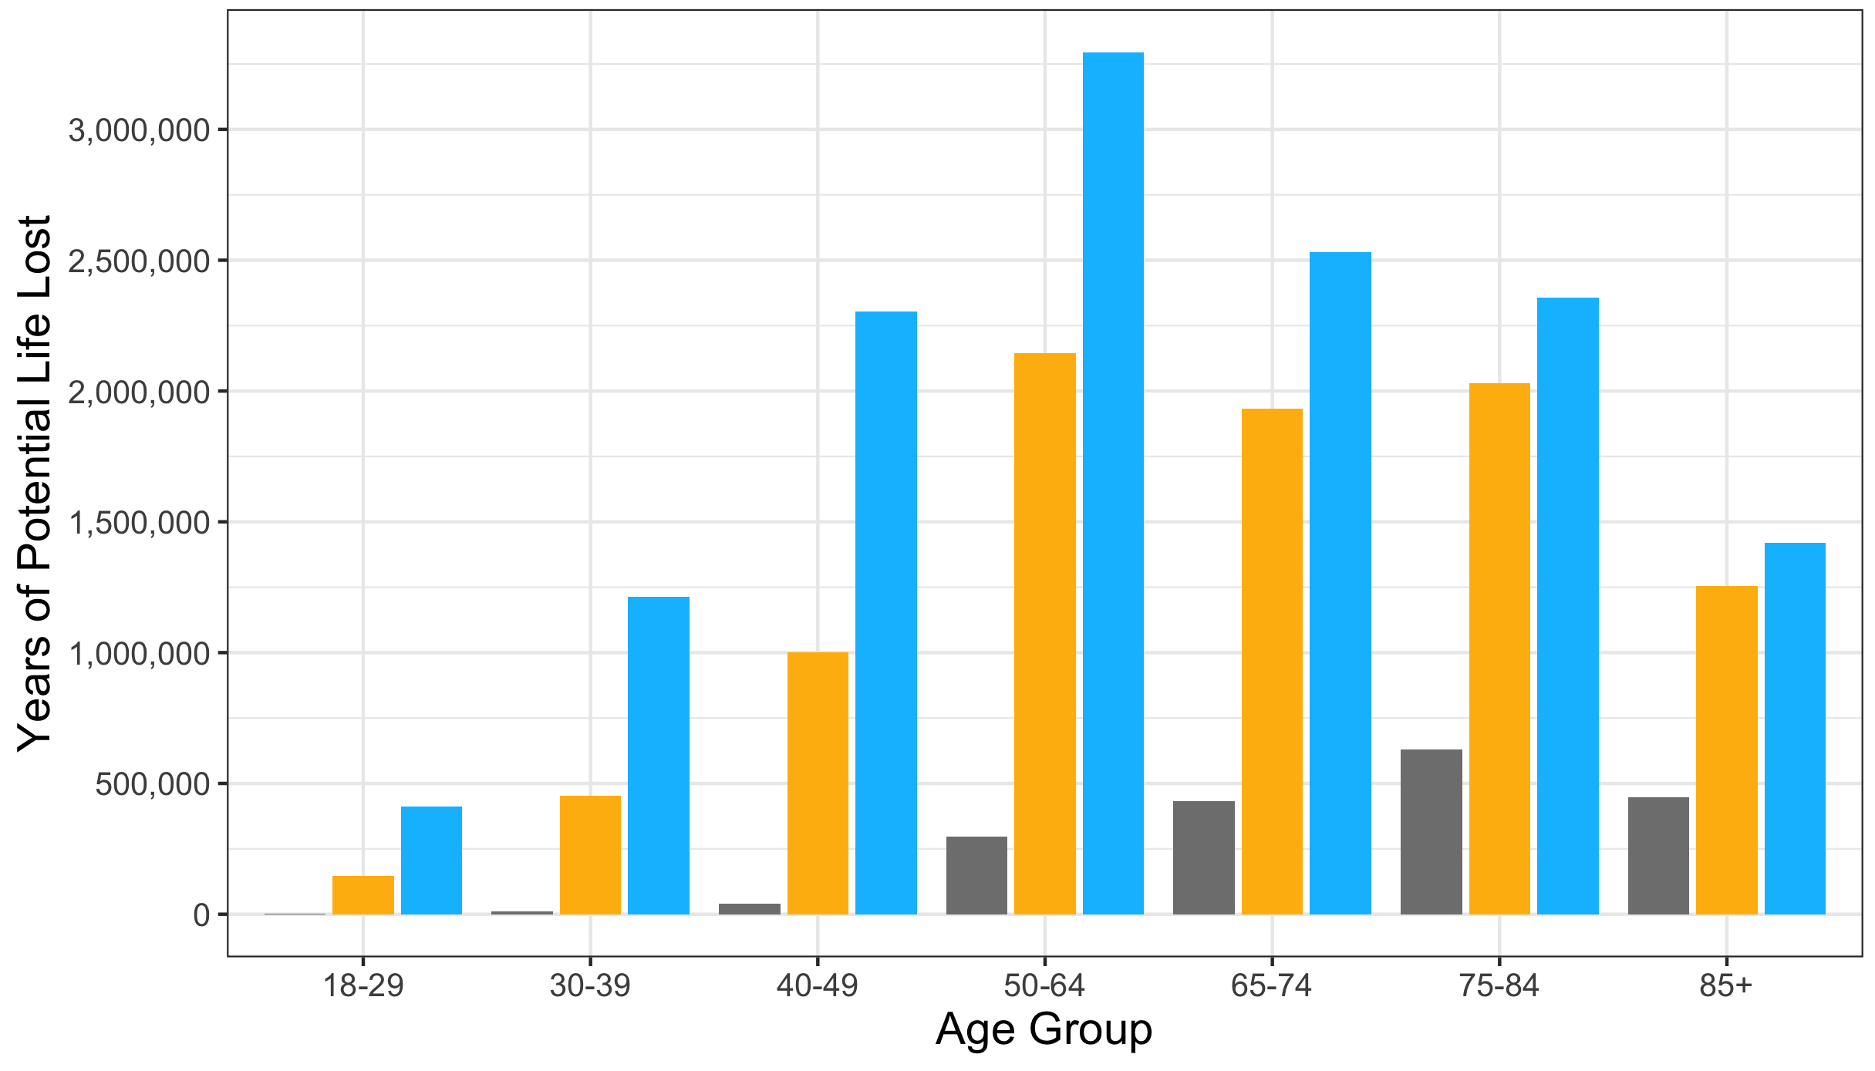
Total years of potential life loss
 | Total years of potential life loss
Age group | Provisional county-level data (no imputation) | Bayesian imputation (mean) | Uniform imputation (mean)
18-29 | 1,141 | 146,108 | 411,511
30-39 | 9,556 | 452,462 | 1,213,177
40-49 | 40,372 | 1,000,480 | 2,304,986
50-64 | 296,615 | 2,144,733 | 3,294,959
65-74 | 432,134 | 1,932,966 | 2,531,840
75-84 | 629,857 | 2,030,041 | 2,357,374
≥85 | 446,644 | 1,255,319 | 1,419,141

Slide 18
Appendix

Slide 19
Mortality data
Life expectancy: https://www.cdc.gov/nchs/data/vsrr/VSRR10-508.pdf
Death data: https://www.cdc.gov/mmwr/volumes/70/wr/mm7014e1.htm
COVID-19 death certificates: https://www.cdc.gov/mmwr/volumes/70/wr/mm7014e2.htm
Total deaths: https://www.cdc.gov/nchs/nvss/vsrr/covid19/index.htm

Slide 20
Model specification
Likelihood
Prior distribution
Notation
$i$: state index
$j$: county index
$t$: quarter index
$Y_{ijt}$: COVID-19 death count at county $j$ state $i$ at quarter $t$
${\overset{˜}{X}}_{ijt}^{T}$: the design matrix for the zero part, including the intercept and quarters
$X_{ijt}^{T}$: the design matrix for the estimation of positive values, including the intercept, age groups, types of counties, quarters, and log of population size
$k$: index of the fixed effect in zero part
$l$: index of the fixed effect in the estimate of positive value
$$\begin{matrix}P(Y_{ijt}=0) & =1-p_{ijt} \\ P(Y_{ijt}>0) & =p_{ijt}⋅Gamma(shape,\frac{shape}{exp(μ_{ijt})})\end{matrix}$$
$$\begin{matrix}γ_{k} & ∼Normal(0,10) \\ α_{ij} & ∼Normal(0,10) \\ β_{l} & ∼Normal(0,10) \\ shape & ∼gamma(0.1,0.1) \\ θ_{i} & ∼Normal(0,1) \\ θ_{0} & ∼Normal(0,1) \\ ν_{ij} & ∼half\text{-}T(3,0,2.5),ν_{ij}>0 \\ {\overset{˜}{ν}}_{i} & ∼half\text{-}T(3,0,2.5),{\overset{˜}{ν}}_{i}>0 \\ ϕ_{i} & ∼Normal(0,1) \\ ϕ_{0} & ∼Normal(0,1) \\ u_{ij} & ∼half\text{-}T(3,0,2.5),u_{ij}>0 \\ {\overset{˜}{u}}_{i} & ∼half\text{-}T(3,0,2.5),{\overset{˜}{u}}_{i}>0\end{matrix}$$
Estimation of zero part
Time trend:
$$\begin{matrix}logit(p_{ijt}) & ={\overset{˜}{α}}_{ij}+{\overset{˜}{X}}_{ijt}^{T}γ \\ {\overset{˜}{α}}_{ij} & =θ_{i}+ν_{ij} \\ {\overset{˜}{α}}_{i} & =θ_{0}+{\overset{˜}{ν}}_{i}\end{matrix}$$
County level:
State level:
Estimation of positive value
Time trend:
$$\begin{matrix}μ_{ijt} & =α_{ij}+X_{ijt}^{T}β \\ α_{ij} & =ϕ_{i}+u_{ij} \\ α_{i} & =ϕ_{0}+{\overset{˜}{u}}_{i}\end{matrix}$$
County level:
Constraint of the missing values
State level:
$$ymiss_{ijt}∼Uniform(0.99,9.01)$$

Slide 21
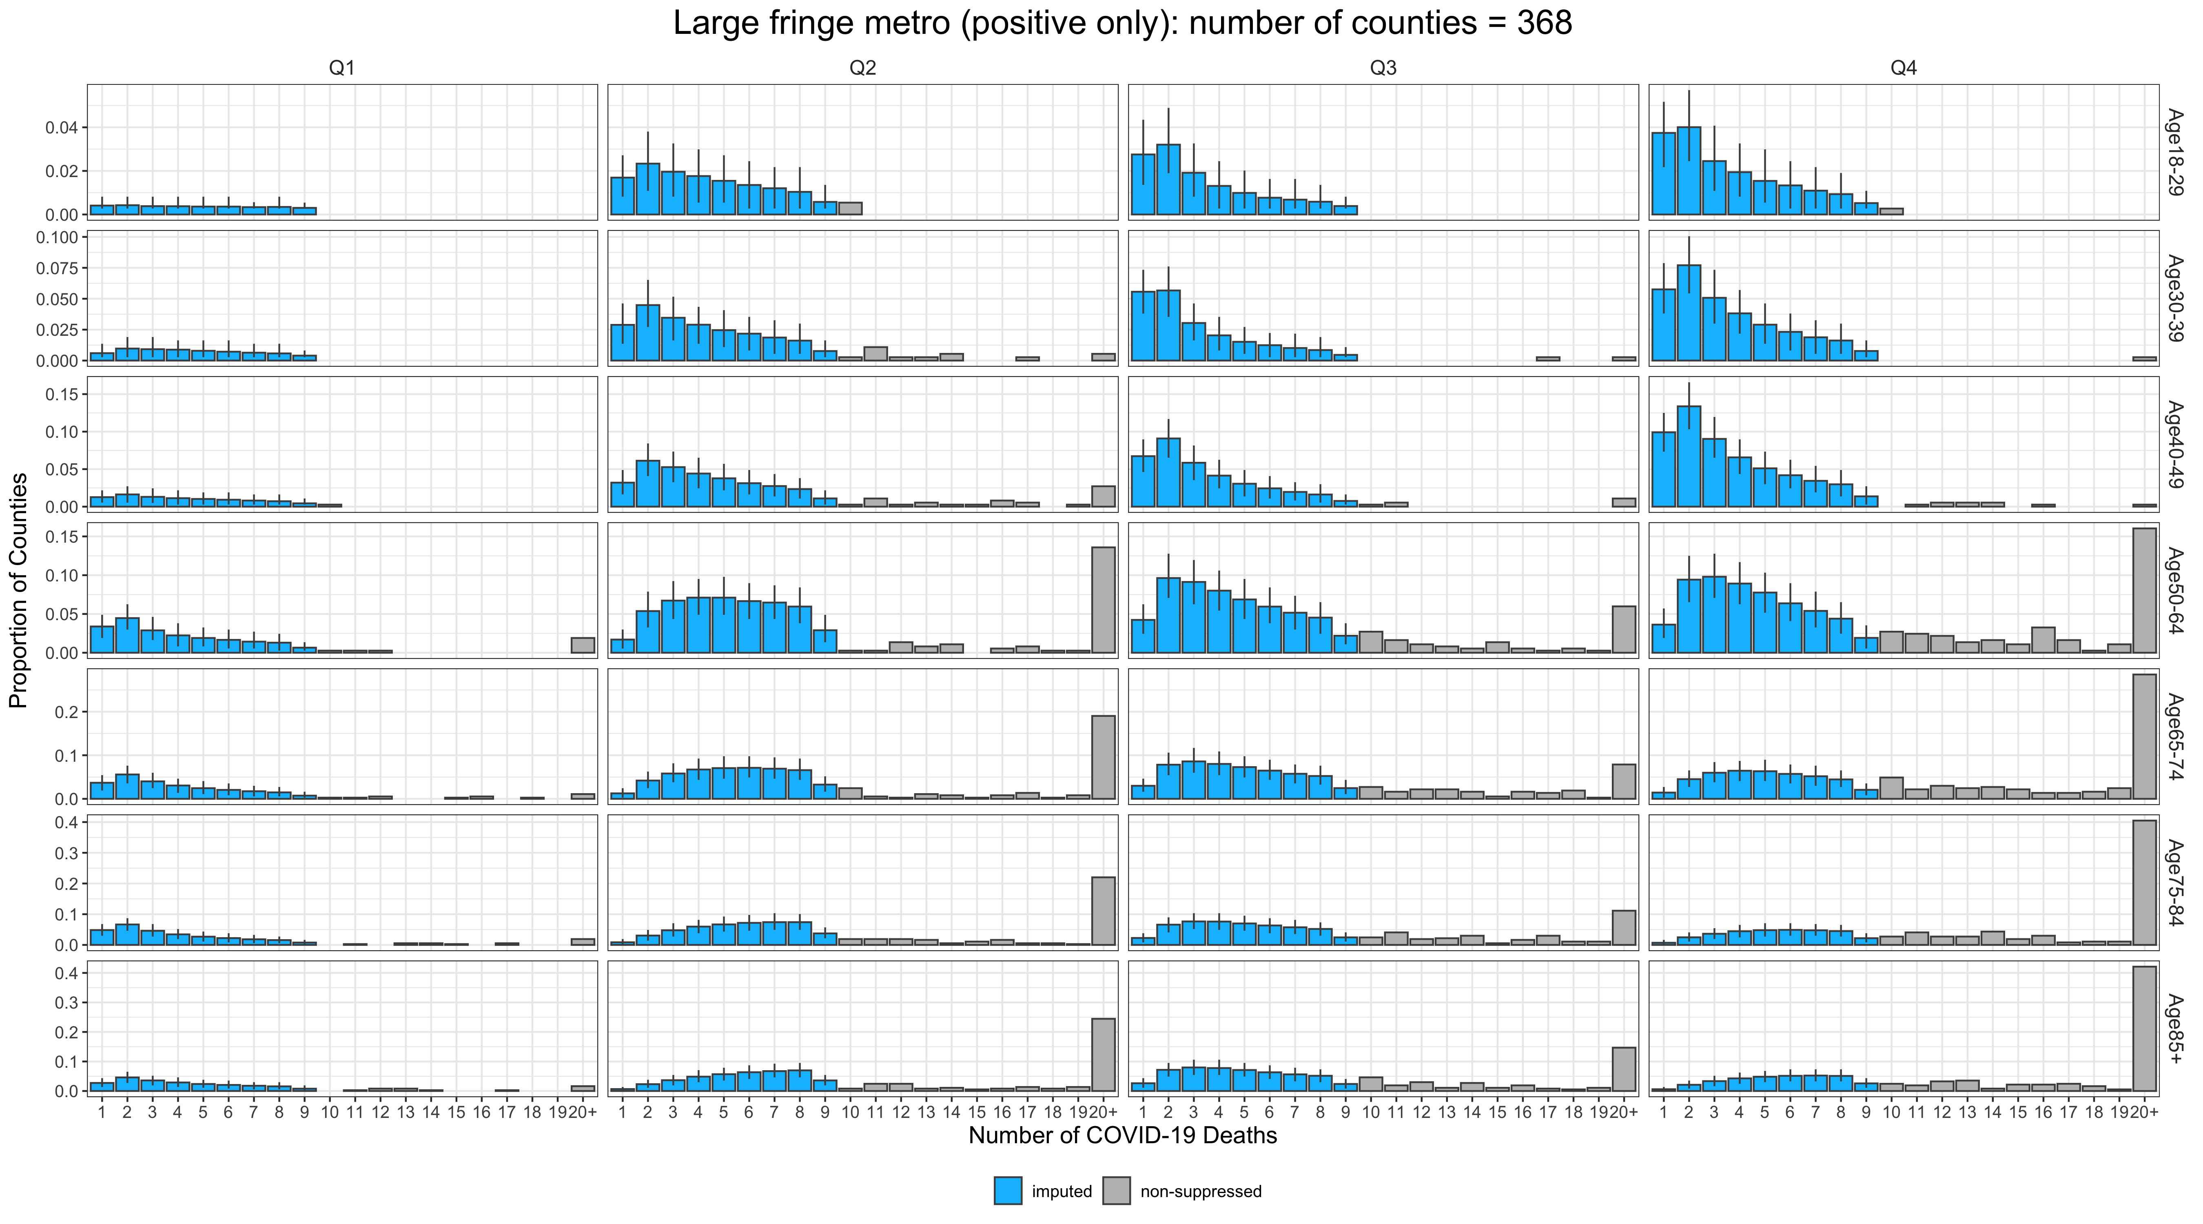
Imputation: Large fringe metro
Observed data
Imputed data

Slide 22
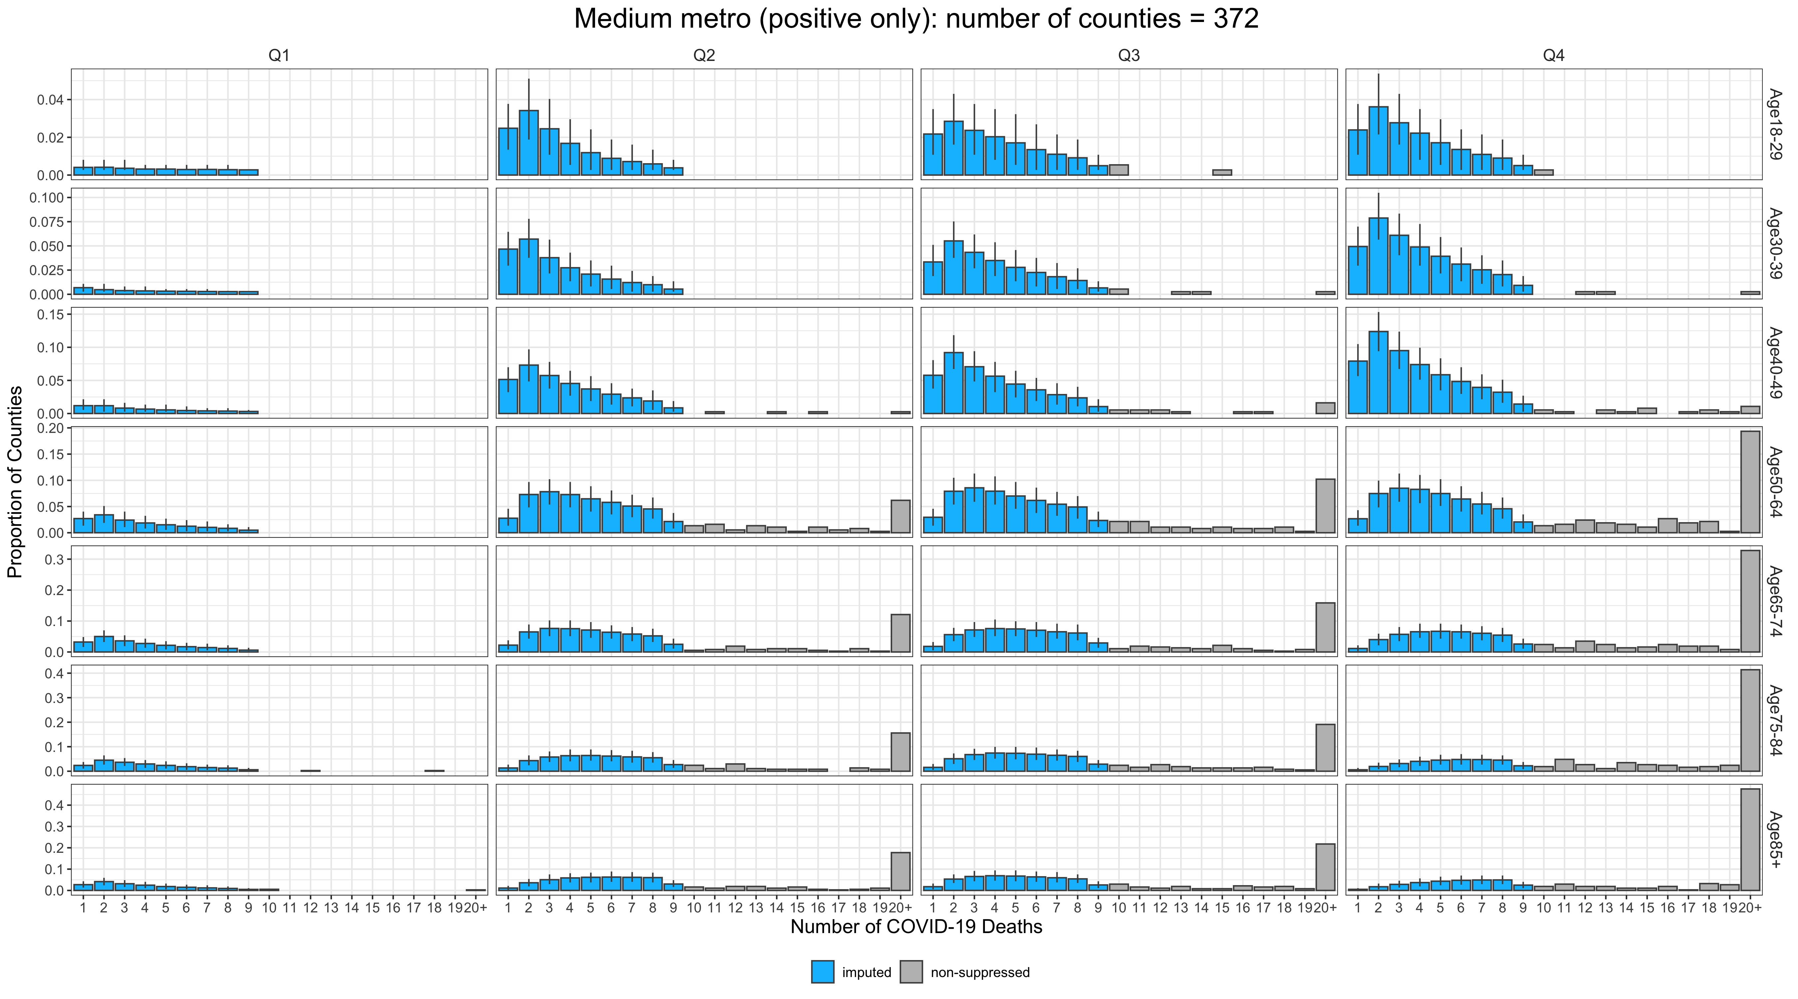
Imputation: Medium metro
Observed data
Imputed data

Slide 23
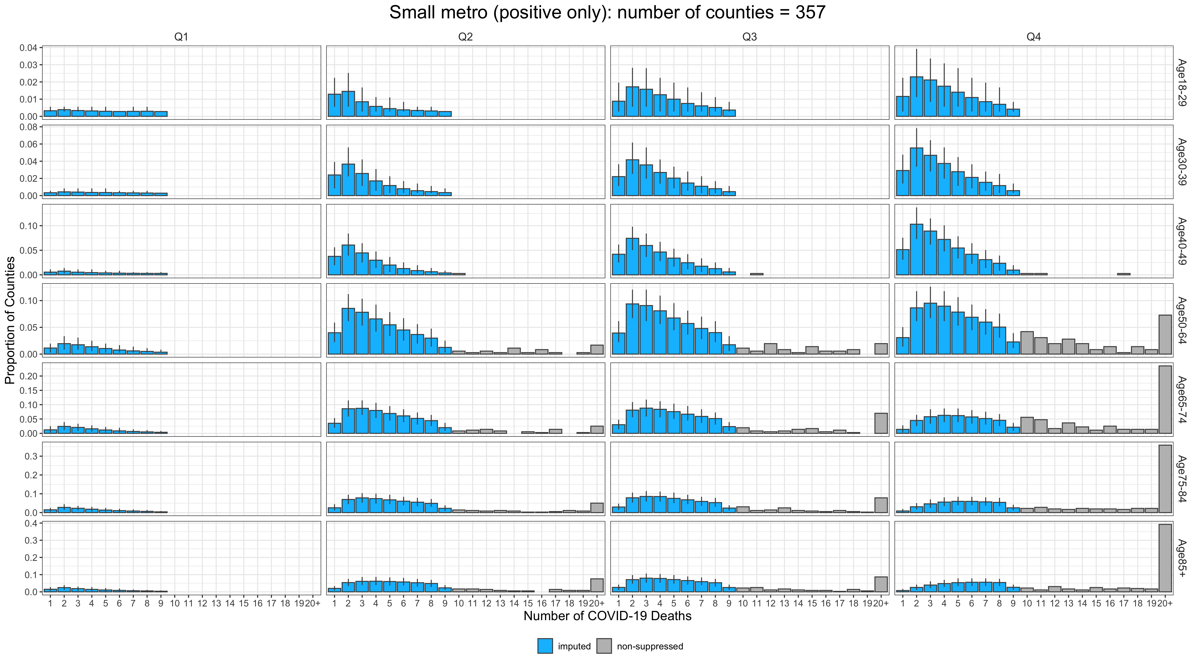
Imputation: Small metro
Observed data
Imputed data

Slide 24
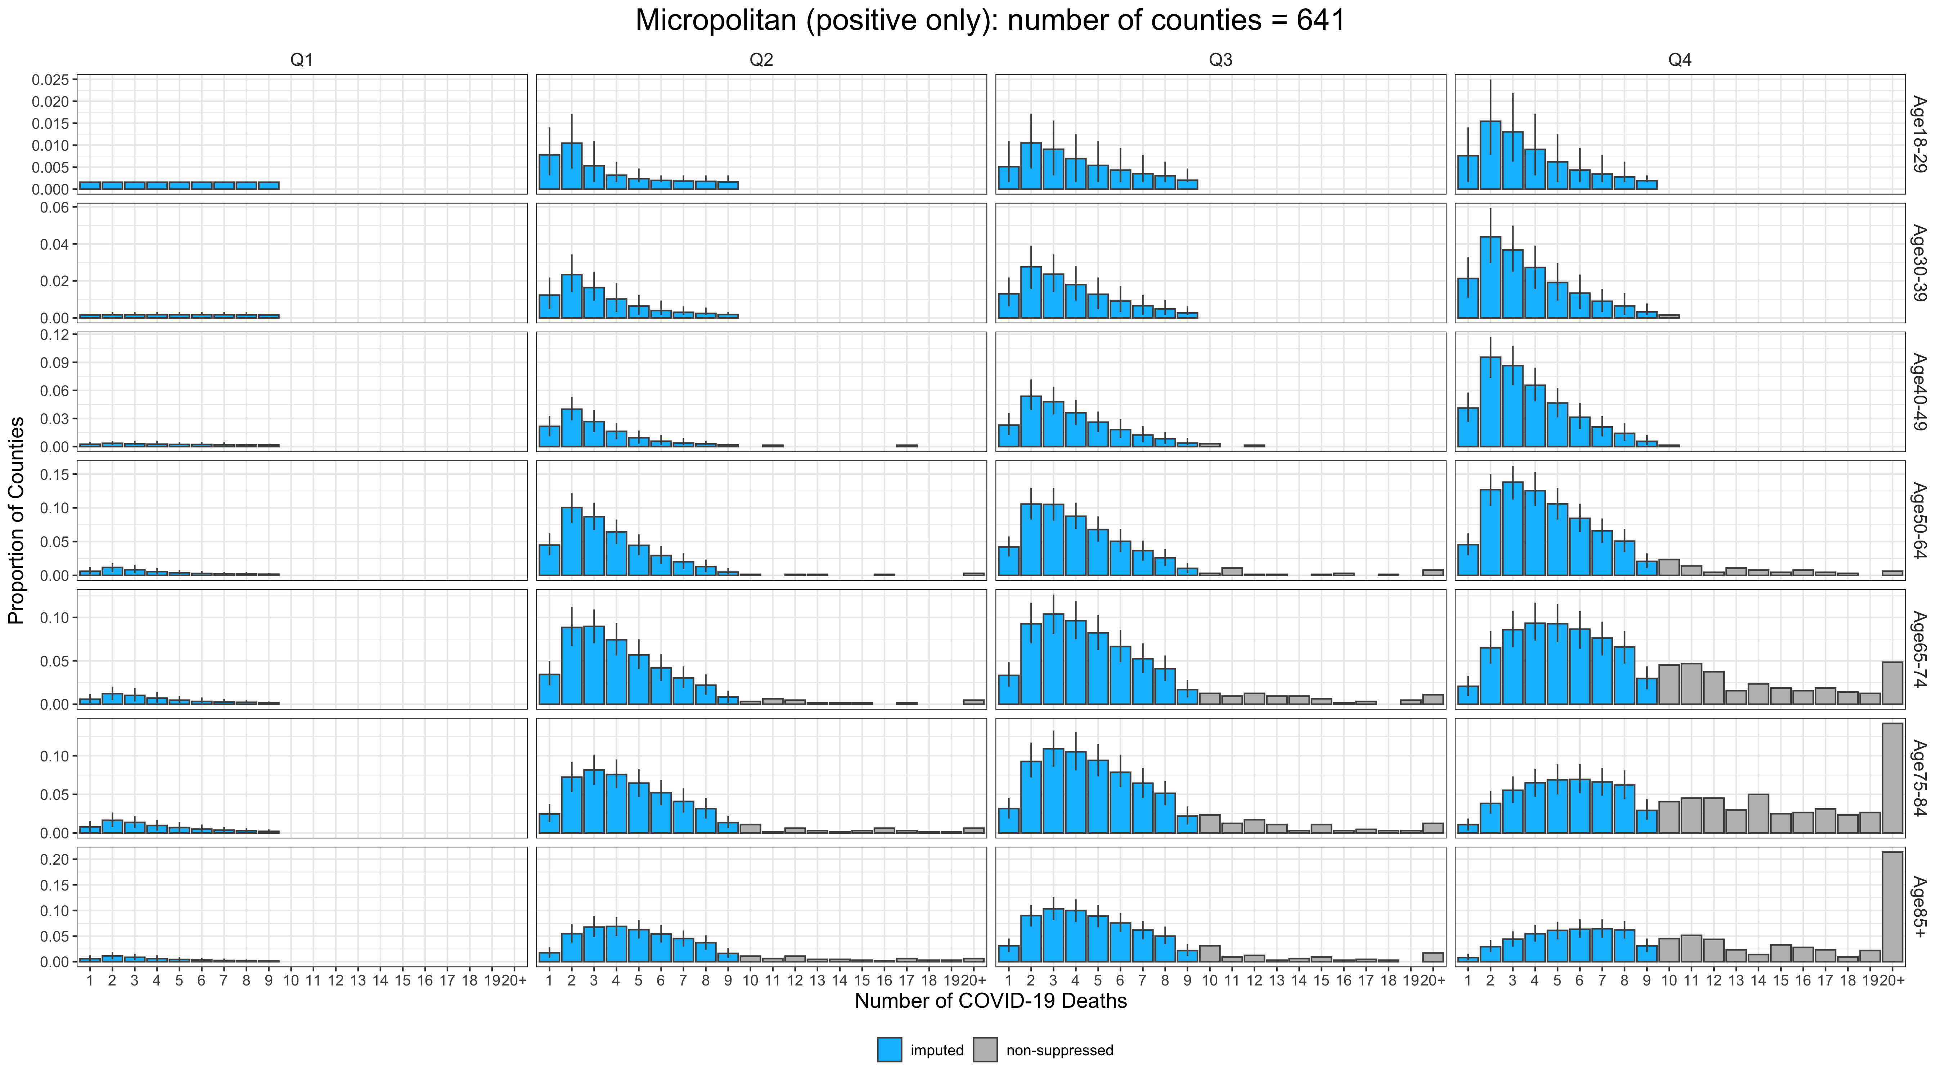
Imputation: Micropolitan
Observed data
Imputed data

